Slide 1
C#
Language Core
Tanveer Ahmad

Slide 2
Overview of language basics
C# language basics
Console applications
Variables, constants, data types
Selection structures – if-else, switch
Iteration structures (loops) – while, do-while, for, foreach, recursion
Data structures – arrays, collections, lists, dictionaries, structs
Methods
Error handling
Algorithms, flowcharts and decision tables
Sorting

Slide 3

Study skills for coding
Code – lots!
“The only way to learn a new programming language
is by writing programs in it.” - Dennis Ritchie, creator of C and Unix
Read important material at least twice
Coding concepts are complex and most people don’t understand them the first time
Collect working examples of code related to key concepts
Play with the code and try out ways you might use it
Don’t try to code all night
Working on screens at night disrupts sleep
Evidence at: https://justgetflux.com/news/2014/12/21/advice.html
Ask for help if you need it
Tutors will help whenever you need them
Excellent programming support websites include: StackOverflow, Code Project
Tutorial and reference websites include: Microsoft Developer Network
Have faith in yourself!
Everyone struggles with coding at first, but practice and persistence lead to progress

Slide 4
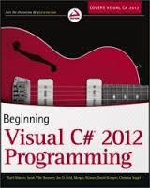
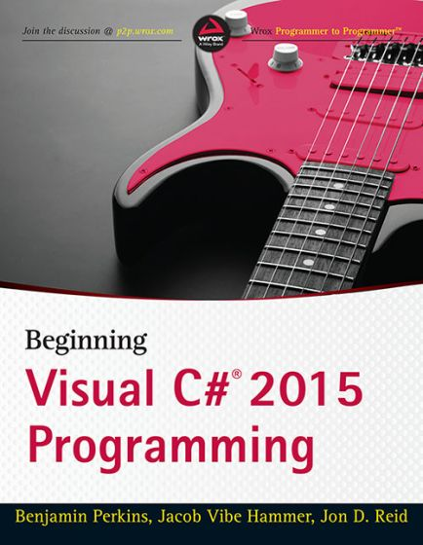
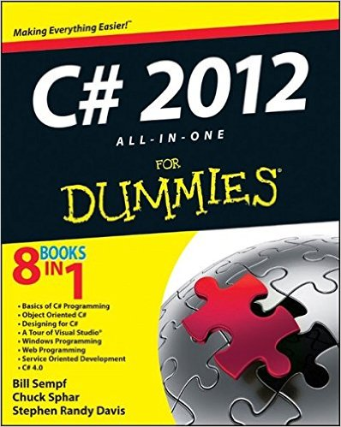
Recommended book
Beginning Visual C# 2012 Programming by Karli Watson et al.
Excellent book
First 18 chapters are free of major errors
Any minor errata will be on publisher’s website
Problem on p555 in Chapter 19 – if you get stuck on it, let me know
Code downloads on publisher’s website: www.wrox.com
You might also find useful as a reference book:
C# 5.0 for Dummies (All-in-One) by Bill Sempf et al.
Not a tutorial book – no exercises
Explanations are generally clear and simple

Slide 5
C# - formative assessment
What do you already know about C#?

Slide 6
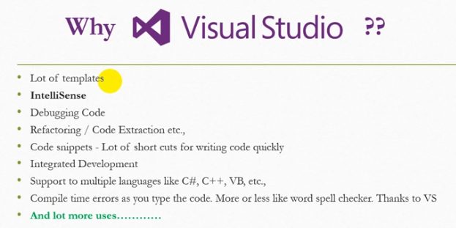
https://dotnetfiddle.net/

Slide 7

C# - background, history and development
High level programming language
Object-oriented
Strongly-typed
Developed in 2000 by Anders Hejlsberg of Microsoft
Similar to Java, developed in 1994 by James Gosling of Sun Microsystems
Also influenced by C++ and C (Bjarne Stroustrup, Dennis Ritchie)
Part of the .NET framework and benefits from the runtime support and class libraries in .NET
.NET makes it easier for your code to communicate with the Windows operating system

Slide 8
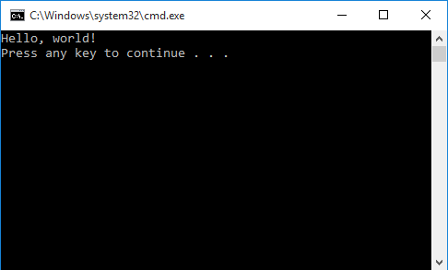
Basics of C#
A simple console application:
using System;
namespace SimplestProgram
{
class Program
{
static void Main(string[] args)
{
Console.WriteLine(“Hello, world!”);
}
}
}

Slide 9
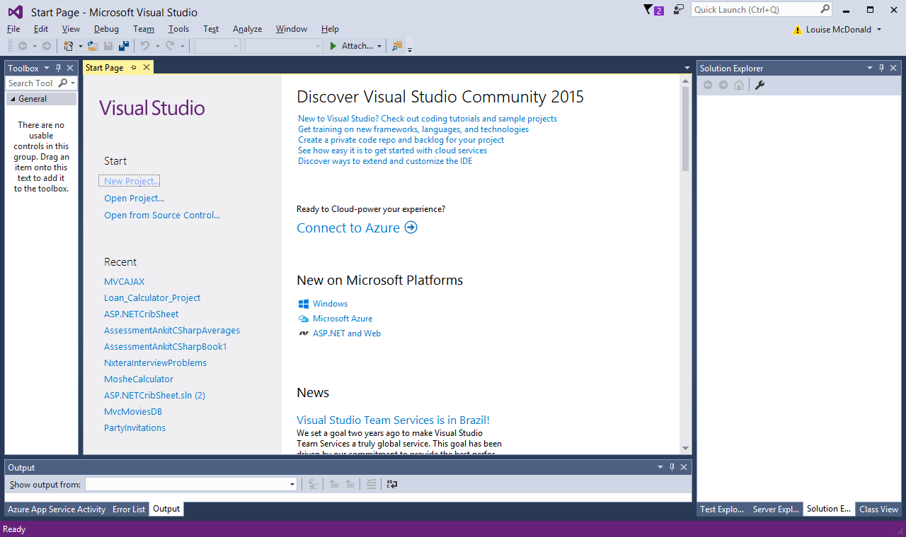
Visual Studio – starting a new project
For console applications, select New Project
Always start a new project for each console application (all the coding exercises for this part of the course)

Slide 10
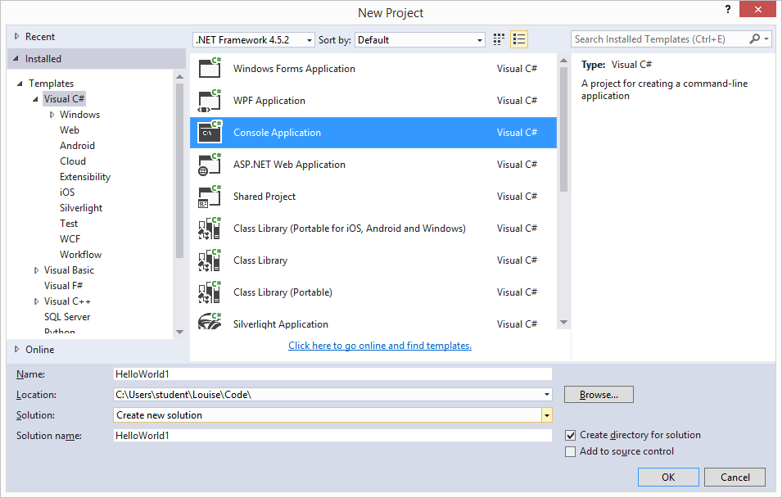
Visual Studio – naming a project
Make sure Visual C# is selected
Select Console Application from the list
Name your project something meaningful
Choose a folder
Click OK

Slide 11
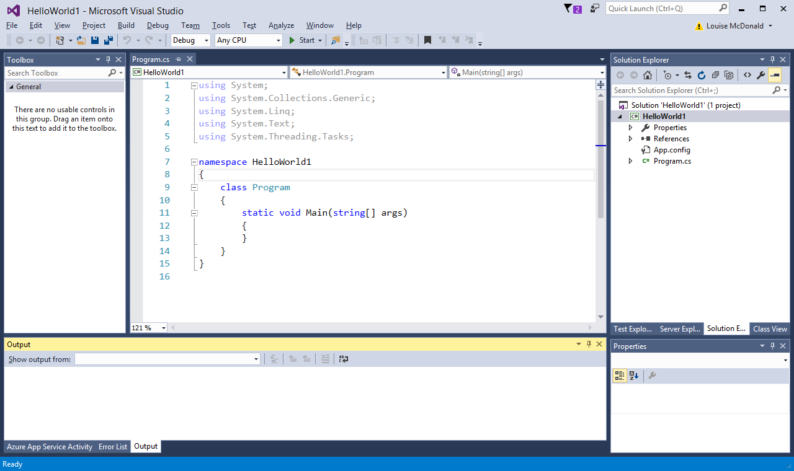
Visual Studio – main windows
Main code window
List of files
Output window – errors also shown here

Slide 12
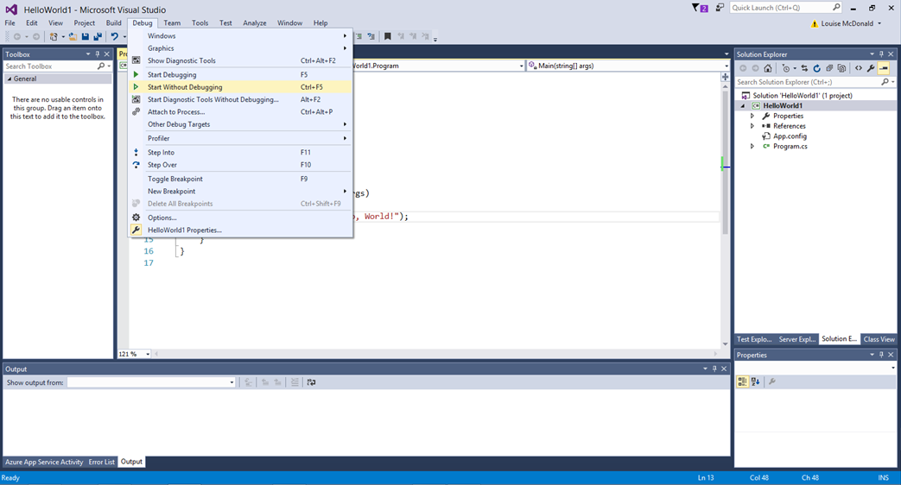
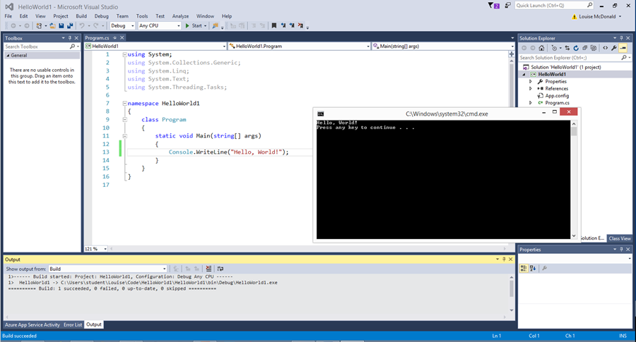
Visual Studio – compiling code
Successful compilation
Compiling without debugging (Ctl+F5) is much quicker than compiling with debugging (F5)

Slide 13
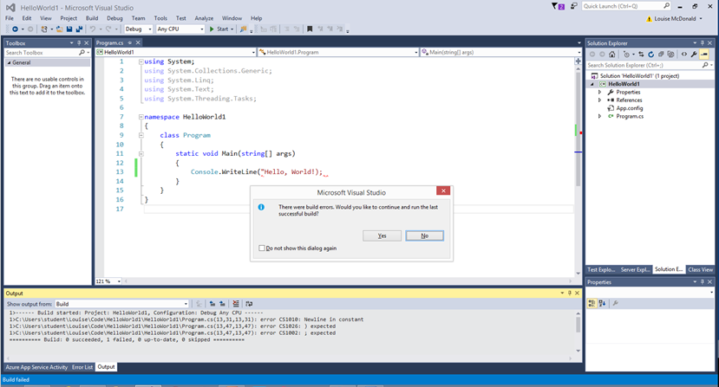
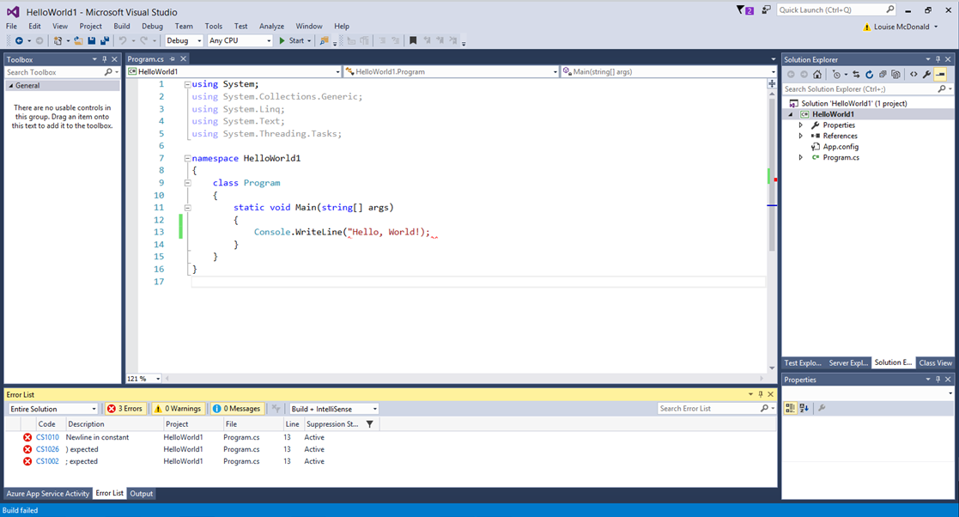
Visual Studio – compilation errors
Click on the Error List tab to see the errors and click on individual errors to jump to their location in the code

Slide 14
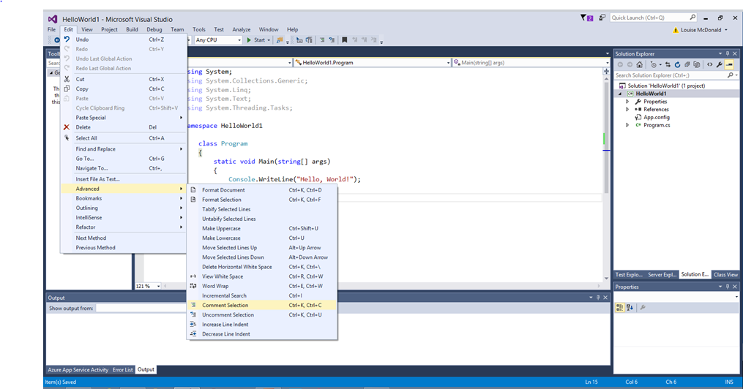
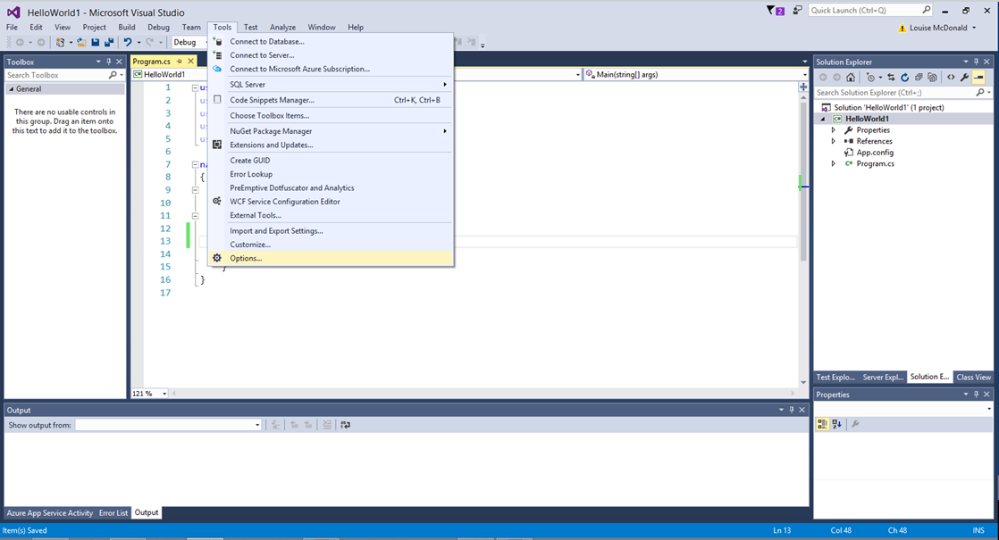
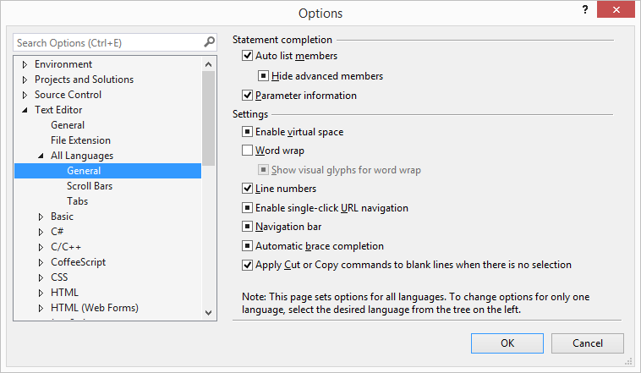
Visual Studio – useful features
Commenting and indenting
Line numbers

Slide 15
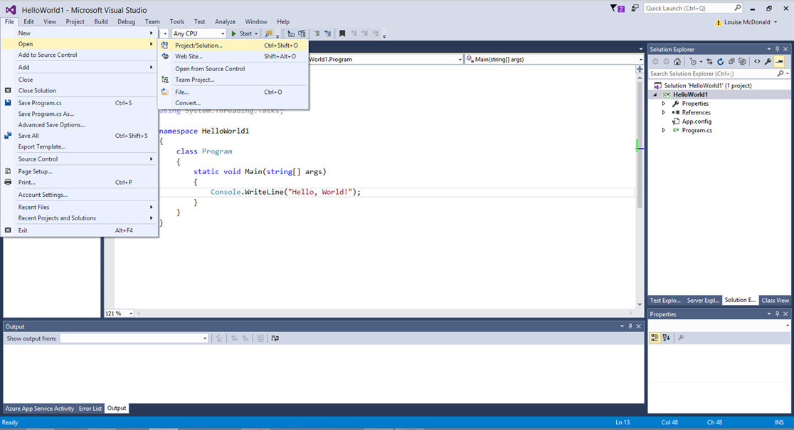
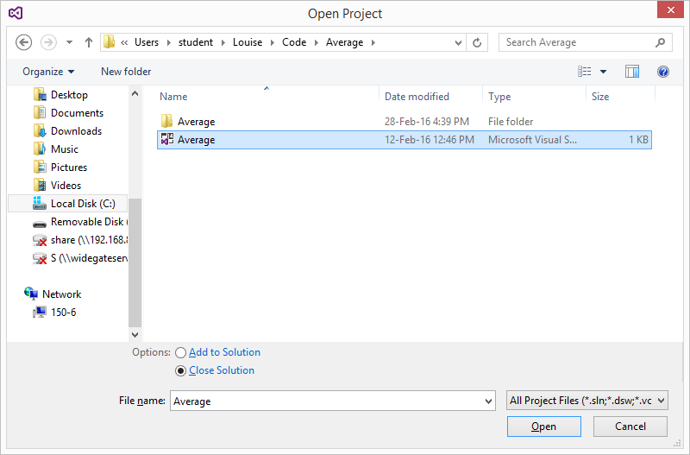
Visual Studio – opening a project
When opening an existing project, select the .sln file. This is VERY IMPORTANT

Slide 16
Data Types

Slide 17

Variables
Variables
Memory storage location that has a name
Temporary – only lasts as long as the program is running
Most languages insist on knowing what kind of data is being stored
Makes sure that data is encoded correctly for storage
Some languages decide data types at runtime, based on the contents of the variable
= dynamically typed, e.g. Python, Javascript

Slide 18
Variables
Variables
Must be declared when they are first used
Declaring a variable means stating its type and name
But don’t try to declare the same variable again – this will cause an error
Good idea to give them an initial value – reduces errors
0 for numbers
“” for strings or ‘ ‘ for chars
Can be global or local
Global – available in the entire program
Local – only available in the function or loop where it is declared
This is called scope
int total = 0;
string answer = “”;
int globalVariable = 0;
Public static void myMethod()
{
int localVariable = 0;
localVariable++;
globalVariable++;
}
globalVariable++;
//this will cause an error
localVariable++;
Scope of
local
variable
Scope of global variable

Slide 19
Variables and constants
Variables
Can be changed, e.g.
int anyInteger = 10;
anyInteger = 11;
Constant
Can’t be changed
This won’t compile:
const int ANY_CONSTANT = 10;
ANY_CONSTANT = 11; (it will give you error here)

Slide 20

Variables and constants - naming
Naming rules for variables and constants:
Must begin with a letter or underscore
Can contain only letters, numbers and underscores
Must not exceed 255 characters
Must be unique within the scope that it is defined
C# is case-sensitive!
Car and car are different variable names
Good practice
Meaningful names
Using camel case for variables helps readability
E.g. aNumber, birthdayCake

Slide 21
Primitives

Slide 22
Data types
Computers ‘think’ in binary (1s and 0s)
We need to tell them how to translate between binary and information that we humans can understand
Data types
Primitive or elementary
Integer – 20 is represented as 00010100
Float – 3.1459 is represented as 0 10000100 11001001000011111100111
Character – ‘a’ is 0110 0001 in ASCII and UTF-8
Boolean – true is 00000001 and false is 00000000 (must be a byte – bits don’t have addresses)
Derived – consist of combinations of primitive data types
Strings
Structs
Classes used to create new data types in object-oriented programming

Slide 23
Common data types in C#
What do you know about each of these?
Integer
Decimal
Char
String
Boolean

Slide 24
Data types and storage
Types for storing real numbers
 | Float | Double | Decimal
Size of storage | 4 bytes | 8 bytes | 16 bytes
Signed? | signed | signed | signed
Range | ±1.5 x 10⁻⁴⁵ to ±3.4 x 10³⁸ | ±5.0 x 10⁻³²⁴ to ±3.4 x 10³⁰⁸ | (-7.9 x 10²⁸ to 7.9 x 10²⁸) 10⁰⁻²⁸
Precision | 7 digits | 15-16 digits | 28-29 digits
Declaration | float aFloat = 1.234F; | double aDouble = 123.4; double anotherDouble = 1234D; | decimal aDecimal = 123.4M;
https://www.dotnetperls.com/suffix

Slide 25
Complete list of data types in C#
Type | Size | Range | Type | Size | Range
sbyte | 1 byte | -128 to 127 (2⁷) | byte | 1 byte | 0 to 255 (2⁸)
short | 2 bytes | -32,768 to 32,767 (2¹⁵) | ushort | 2 bytes | 0 to 65,535 (2¹⁶)
int | 4 bytes | -2,147,483,648 to 2,147,483,647 (2³¹) | uint | 4 bytes | 0 to 4,294,967,295 (2³²)
long | 8 bytes | -9,223,372,036,854,775,808 to 9,223,372,036,854,775,807 (2⁶³) | ulong | 8 bytes | 0 to 18,446,744,073, 709,551,615 (2⁶⁴)
float | 4 bytes | ±1.5 x 10⁻⁴⁵ to ±3.4 x 10³⁸
double | 8 bytes | ±5.0 x 10⁻³²⁴ to ±3.4 x 10³⁰⁸
decimal | 16 bytes | (-7.9 x 10²⁸ to 7.9 x 10²⁸) 10⁰⁻²⁸
 |  |  | char | 2 bytes | Any Unicode character
 |  |  | string | - | 0 or more Unicode characters
 |  |  | bool | 2 bytes | True or false
Signed
Unsigned

Slide 26
Summary of data storage
Numeric data types
Integer for whole numbers
Decimal for high-precision decimals
Other data types
Text
Char - ‘a’
String – “This is a string”
Boolean
true or false
Data can be cast from one type to another
e.g. if myNumber was an int and you wanted to store its value in a variable of type decimal:
decimal result = (decimal)myNumber
Some data types can’t be cast to some other data types, but can be converted (we’ll see this later)

Slide 27
Data storage - exercise
Which of these will compile?
double num = 2.0;
string ohSnap = "%$^&$ ";
int num2 = 10.9;
byte smallNum = -42;
char word = 'word';
long bigNum = 12345678.9;
float x = 3.5F;
decimal deciNum = 4.2m;

Slide 28
namespace PrimitiveDataTypes
{
class Program
{
static void Main(string[] args)
{
double num = 2.0;
string ohSnap = "%$&$";
string helloWorld = "Hello World";
long num2 = 123456.9;
Console.WriteLine(helloWorld);
}
}
}

Slide 29
C# exercises - tips
Create a folder for your C# code
Don’t use spaces in the folder name
Don’t put it under the Documents folder – things can go wrong if you do
Give your folders and projects meaningful names
Start a new console application project in Visual Studio for each exercise
This will keep your code tidy
Don’t have more than one copy of Visual Studio open at a time
This will slow your machine down and increase the risk of glitches in Visual Studio
If you want to look at previous code, you can go into Windows Explorer and open the files using a text editor, such as Notepad or Brackets

Slide 30
Assignment Statements

Slide 31
Assignment statements
In an assignment statement, the programmer asks that a value is assigned to a variable
Value can be a number, arithmetic expression, character, string, boolean or any appropriate data type
The variable is on the left
The value that is put into it is on the right
nameOfVariable = value
myNumber = 3 + 5;
message = “Hello, World!”;
salePrice = unitPrice * (1 + vatRate);

Slide 32
Handling user input in console applications
response = Console.ReadLine();
gets user input as a string
This may have to be converted to another data type for use in your program
Integer
response = Convert.ToInt32(Console.ReadLine());
Character
response = Convert.ToChar(Console.ReadLine());
Strings (and characters) may need to be converted to a uniform case if they are part of a test condition
response = (Console.ReadLine()).ToLower();
if (response == “yes”) …

Slide 33
Selection

Slide 34
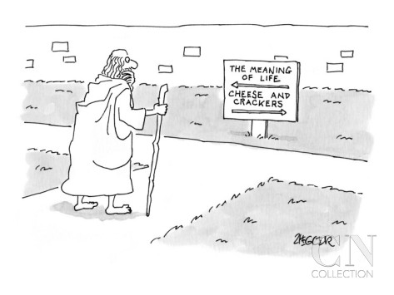

Control structures
Selection – for making a choice
If-else
Switch-case
Iteration – for repeating actions
While
Do-while
For
Recursion
Subprograms – for structuring code and reducing duplication of code
Functions/procedures/methods

Slide 35

Selection structures
If
Used for testing whether a condition is true, then acting on it
Else used to deal with situations where the condition is false
Switch
Used to choose between several alternatives

Slide 36
Selection – if-else
Tests a condition
True performs the if
False performs the else
Can be nested
An if statement can be inside another if statement
Often uses logical operators
== is equal to
&& logical AND
|| logical OR
!= not equal to
! logical NOT
if (score == 10)
{
Console.WriteLine(“Wow! Top score!!”);
}
else if ((score >= 5) && (score <=9))
{
Console.WriteLine (“Well done – you passed!”);
}
else
{
Console.WriteLine (“Sorry, you didn’t pass.”);
}

Slide 37
Selection structures - if
Conditions for if statements (also for while and do while statements)
Used with integer and Boolean variable types
If a single condition is true or false
if (condition == true)
if (number != 10)
If two or more conditions are both true
Uses logical and - &&
if ((conditionA == true) && (conditionB == false))
If one of two conditions is true
Uses logical or - ||
if ((conditionA == true) || (conditionB == true))
If one but not both of two conditions is true
Uses logical XOR
if ((conditionA == true) ^ (conditionB == true))

Slide 38
Selection structures – if - truth tables
Logical AND
Logical OR
Logical XOR
A | B | result
F | F | F
T | F | F
F | T | F
T | T | T
A | B | result
F | F | F
T | F | T
F | T | T
T | T | T
A | B | result
F | F | F
T | F | T
F | T | T
T | T | F

Slide 39
Selection structures - if – coding exercise
You are thinking of a particular number
Write a simple program that prompts a user to enter numbers to help them guess which number you are thinking of
Use one or more if-else statements to check whether the number they enter is greater or less than the number you are thinking of
Extension 2: use a random number generator to select the number to guess
Extension 3: Write a Validation method of user input
GuessTheNumber

Slide 40
Sub Programs

Slide 41

Subprograms
static void Message(string name)
{
Console.WriteLine("Hello, " + name + ". How are you?");
}
Functions, procedures and methods are essentially the same thing
Each is a block of code that
Has a name
May have inputs (parameters)
May have outputs (return values)
Can be called from other parts of the program
Advantages of using them:
Reuses code
Reduces repetition
Makes testing easier
Variables declared inside a function are only valid inside it – this is called scope
Name them with Pascal case
Capital letter for every word
e.g. SomeMethod
Message(“Monsieur Pascal”);
static int AddNumbers(int firstNumber, int secondNumber)
{
int total;
total = firstNumber + secondNumber;
return (total);
}
int result = AddNumbers(3,4);

Slide 42
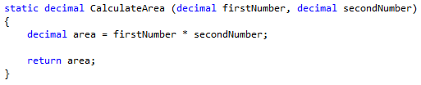

Methods
Input parameters
Type Name that is used for them in the method
Type of return value
Method name
Return statement
Name of variable being returned
(as used in the method)

Slide 43
Selection – switch-case
Used to choose between several alternatives
when you want a different outcome for many or all of the options
These are usually numbers, characters or strings
For conditions, like (x < 10) or Boolean statements, use if-else
string yourName = Console.ReadLine();
switch (yourName)
{
case “judith":
case “elizabeth":
reply = “That’s one of my favourite names.";
break;
case “edna":
reply = “That’s the name of the auntie that I didn’t
like much.";
break;
default:
reply = "Please tell me your name:";
break;
}

Slide 44
Exercise Switch statement coding
Create an arithmetic calculator which should add, subtract, multiply, divide and find the modulus of given numbers.
Ask user to enter two numbers and an arithmetic operator.
Define a separate function for each arithmetic operation.
Use switch statement to call a specific function based on user’s choice.
Output the result on the screen
Extension: Continue asking user’s to enter numbers and arithmetic operators, until user enters an exit button (e.g. press q or x).
Calculator

Slide 45
Exercise Switch statement coding
A grading system for HND students, where
D- Distinction (75% and above marks)
M- Merit (marks more than 65% and less than 75%)
P- Pass (marks more than 50% and less than 65%)
R - Referred (marks more than 35% and less than 50%)
WH – Withheld (marks equal to 10%)
US -Unreasonable Submission (5%)
A user enters a grade and relevant percentage marks displayed.
The system should be case insensitive.
Default message displayed, if the grade is not found in available options.
Grading System

Slide 46
Iteration

Slide 47
Iteration structures (loops)
While
Do while
For
For each

Slide 48
Iteration - while
int numberOfTimes = 0;
while (numberOfTimes < 10)
{
Console.WriteLine(" numberOfTimes is : " + numberOfTimes );
numberOfTimes ++;
}
When you want a piece of code to run 0 or more times
Stop condition is at the top
When it’s met, the loop stops running
If it’s met before the loop has been run, then the code in the loop won’t be run at all
A while loop must contain some code that will eventually meet the stop condition by changing the value of the variable in the stop condition, e.g.
Increasing a counter
Getting user input
Otherwise, you get an endless loop
Ctl+C breaks out of an endless loop in the console
bool happiness = true;
while (happiness)
{
EatSomeChocolate();
happiness = CheckIfTheresAnyChocolateLeft();
}

Slide 49
Iteration structures - while
int numberOfTimes = 0;
while (numberOfTimes < 10)
{
Console.WriteLine(" numberOfTimes is : " + numberOfTimes );
numberOfTimes ++;
}
Control condition
Control variable is incremented to make sure that the control condition eventually becomes true (or you can collect user input to end the loop)

Slide 50
Iteration – do-while
When you want a piece of code to run 1 or more times
Stop condition is at the bottom
When it’s met, the loop stops running
If it’s met before the loop has been run, then the code in the loop will be run once
A do-while loop must contain some code that will eventually meet the stop condition by changing the value of the variable in the stop condition, e.g.
Increasing a counter
Getting user input
Otherwise, you get an endless loop
Ctl+C breaks out of an endless loop in the console
Very handy for user input in console applications
If the user enters something invalid, you can loop around and ask them to enter something valid
do
{
Console.WriteLine("Guess a number between 1 and 10: ");
yourNumber = Convert.ToInt32(Console.ReadLine());
} while (yourNumber != numberToGuess);
Console.WriteLine("You guessed right!");
do
{
Console.WriteLine("Guess number “ + numGuesses + “is: ");
guess[numGuesses] = Convert.ToInt32(Console.ReadLine());
numGuesses++;
} while (numGuesses <= 3);
do
{
DrinkABeer();
} while (!drunk);

Slide 51
Iteration structures – do while
int yourNumber=1;
do
{
Console.WriteLine("Guess a number between 1 and 10: ");
yourNumber = Convert.ToInt32(Console.ReadLine());
}
while (yourNumber != 7);
Console.WriteLine("You guessed right!");
User input controls loop
Control condition

Slide 52
Iteration structures – while & do exercise
Ask the user 2 riddles and loop until they get the right answer or give up
Use a while loop for the first riddle
Use a do while loop for the second riddle
Extension 1: allow two or more versions of the answer for each riddle
Extension 2: add several more riddles to the program and tell the user how many they got right at the end, allowing a maximum of 3 attempts per riddle
Riddles

Slide 53
Iteration – for
for (int i = 0; i < 5; i++)
{
Console.WriteLine("Line " + i);
}
When you want a piece of code to run a particular number of times
3 conditions at the top
Start
Stop (condition)
Increment
Easier to code correctly (compared to while and do-while loops) because you can easily see if you’ve left one of the conditions out or made a mistake in them
One of the most-used loops
for (int i = 0; i < 12; i++)
{
Console.WriteLine((i + 1) + " x 2 = " + (i + 1)*2 );
}
for (int i = 0;; i++)
{
Console.WriteLine(“Row " + i);
}
for (int i = 0; i < 5;)
{
Console.WriteLine(“Stripe " + i);
}

Slide 54
Iteration structures - for
Control variable initialised
Loop continues while this is true
for (int i = 0; i < 5; i++)
{
Console.WriteLine("The count is : " + i);
}
for (int i = 0; i < 12; i++)
{
Console.WriteLine((i + 1) + " x 2 = " + (i + 1)*2 );
}
Control variable incremented
Loop continues while this is true
Control variable initialised
Control variable incremented

Slide 55
Iteration structures – foreach
Like a for loop, but especially designed for going through arrays and collections
Only one condition, which includes a variable declaration
Can only be used for retrieving information
Using foreach to add to or delete from an array or collection doesn’t work

Slide 56
Iteration structures – foreach
int[] arrayOfNumbers = { 1, 2, 3, 4, 5, 6, 7 };
foreach (int i in arrayOfNumbers)
{
Console.WriteLine("The value of i is: " + i);
}

Slide 57
Iteration structures – for & foreach loops
You are Snow White and you are serving the seven dwarves with their dinner and a nice warm drink
Declare an array of strings for the dwarves’ names, e.g.
string[] sevenDwarves = { "Happy", "Doc", "Sleepy", "Sneezy", "Dopey", "Bashful", "Grumpy" };
Using a for loop, tell each dwarf by name that his dinner is ready
sevenDwarves[i] inside the for loop will get each value from the array
Using a foreach loop, tell each dwarf by name that his drink is ready
Extension: ask each dwarf what he wants for his dinner and drink, then tell each dwarf by name that his meal/drink is ready, naming his choice as well: e.g. "Doc, your roast beef is ready" or "Sleepy, your cocoa is ready".
Dinners

Slide 58
Iteration – recursion
public static int Factorial (int number)
{
//base condition, which makes the recursion stop
if (number == 0)
{
return 1;
}
else
{
return number * Factorial(number - 1);
}
}
Where a function or method calls itself
It MUST have a stop condition
Called the base condition
Mainly mathematical uses
Calling Factorial(3) | 3 x
calls Factorial(2) | 2 x
calls Factorial(1) | 1 x
calls Factorial(0) | 1

Slide 59
Guess a Number

Slide 60
Methods - exercise
Write a program that asks the user for two numbers and a sign, then performs arithmetic. Each arithmetic operation should be in a method
Extension: Add extra methods for other mathematical operations, such as raising to a power, finding the reciprocal or finding the sine, cosine or tangent. Consider the alterations that you need to the program to get the right number of inputs from the user.

Slide 61
Arrays, Structs, Lists, Dictionaries, Collections

Slide 62
Data structures
Arrays and collections
Can only contain elements of a single data type
Elements accessed with [], e.g. myList[5]
Have methods and properties
To find out more, google ‘c# arrays methods and properties’ (or lists, dictionaries, etc.)
Structs
Can contain a mixture of different data types
Like a record (in a card index file)

Slide 63
Data structures - arrays
An array is a numbered list
Items in the array often called elements, e.g. item[2] is an array element
Numbers that give the position in the array are called indexes
Each element in the array can be accessed by using a unique index
Fixed length (not like Javascript!)
All elements in an array have the same data type
Zero-indexed
First element is: arrayElement[0]
5th element in an array is: arrayElement[4]
Can be multi-dimensional
Loops, especially for and foreach, often used when working with arrays

Slide 64
Arrays
One-dimensional
string[] myArray = new string[7];
myArray[0] = “Tortillas”;
nextThingToBuy = myArray[1]
Two-dimensional
string[,] teamsGrounds = new string[20,2];
teamsGrounds[0,0] = “Arsenal”;
firstGround = teamsGrounds[0,1];
0 | Tortillas
1 | Fajita spices
2 | Onions
3 | Peppers
4 | Chicken
5 | Guacamole
6 | Lettuce
 | 0 | 1
0 | Arsenal | Ashburton Grove
1 | Bournemouth | Dean Court
2 | Burnley | Turf Moor
3 | Chelsea | Stamford Bridge
4 | Crystal Palace | Selhurst Park
5 | Everton | Goodison Park
Question: If we wanted to rewrite the teamsGrounds array to include the number of seats, how would we do it?

Slide 65
Data structures - arrays
Array function | Code
Declaration | int[] numbers = {1, 2, 3, 4, 5}; double[] numbers = new double[5]; decimal[] numbers = new decimal(integerVariable);
Putting a value into an array | numbers[2] = 3;
Getting a value from an array | myNumber = numbers[2];
Array indexes can be variables | myNumber = numbers[anotherIntegerVariable];
Getting the length of the array | arrayLength = numbers.Length;
Arrays can be sorted easily | Array.Sort(numbers);

Slide 66
Data structures - arrays
int[] numbers = {1, 2, 3, 4, 5};
for (int i = 0; i < numbers.Length; i++)
{
total += numbers[i];
}
Length of array used to control for loop
Loop control variable used as array index – makes the loop work through the array
Concatentation operator often useful for calculating totals.
This line means the same as: total = total + numbers[i];

Slide 67
Data structures – arrays - exercise
A user inputs 5 numbers and the program stores them in an array and finds the average.
Extension: create a 5 x 2 array, fill it with numbers, and sum each row and each column then calculate the overall total of the numbers in the array
You will need a nested for loop for this
You will also need to use arrayName.GetLength(0) and arrayName.GetLength(1) to get the lengths of each dimension of the array
Average, TwoDimensionalArray

Slide 68
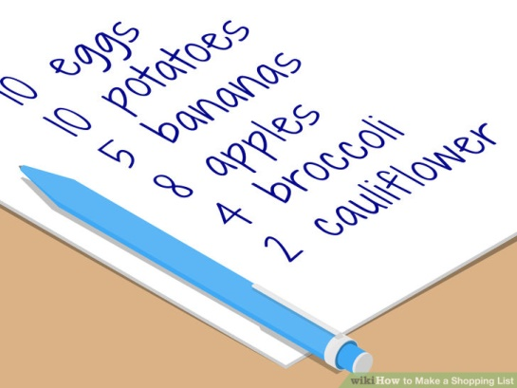
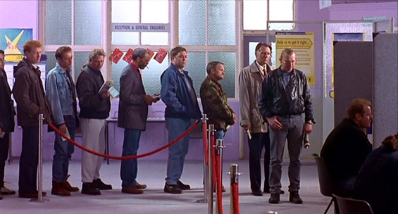
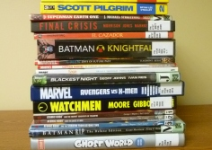
Data structures
List
A collection
Entries arranged sequentially
Indexed like an array
Variable length
Queue
A list where entries are added to the end and removed from the beginning
First in, first out (FIFO)
Stack
A list where entries are added and removed from the top
Adding an entry = pushing
Removing an entry = popping
Last in, first out (LIFO)

Slide 69
Data structures - collections
Collections
Variable length
Unidimensional
Have properties and methods
Several different types:
List<T> - most used
Dictionary<TKey, TValue> - values are referenced by a key – used in ASP.NET MVC ViewBag
HashSet<T> - like a mathematical set with no duplicates – used for database keys
LinkedList<T> - use when the order matters for inserting/deleting
Queue<T> - can only add to the end of the queue and remove from the front (FIFO)
Stack<T> - can only add and remove items at the top of the stack (LIFO)
<T> (or <TKey, TValue>) stands for data type. That means it can be replaced by int, string, double, etc. when using a collection. (This leads to a topic called generics, but we won’t cover that at this stage.)

Slide 70
Data structures - lists
Order of elements doesn’t matter
Elements usually addressed by value
They do have indexes but the indexes aren’t often used
List lengthens and shortens according to the number of elements in it
List<string> booksToRead = new List<string>() {“War and Peace”, “Ready Player One”, “The Girl on the Train”};
0 | War and Peace
1 | Ready Player One
2 | The Girl on the Train
booksToRead.Add(“The Ruby in the Smoke”);
booksToRead.Remove(“Ready Player One”);
0 | War and Peace
1 | Ready Player One
2 | The Girl on the Train
3 | The Ruby in the Smoke
0 | War and Peace
1 | The Girl on the Train
2 | The Ruby in the Smoke

Slide 71
Data structures – collections - lists
List function | Code
Declaration | List<int> intList = new List<int>(); List<int> intList = new List<int>() {1, 1, 2, 3, 5};
Adding a value | intList.Add(3);
Removing a value | intList.Remove(3);
Finding the length | listLength = intList.Count;
Checking if something is in the list | bool inList = intList.Contains(3);
Sorting the list | intList.Sort();

Slide 72
Data structures – collections - lists
Create a program that contains a list of book titles and allows you to add a book or enter “x” to quit. After the user has quit, display all the books.
Extension: Create a program that contains a list of book titles and allows you to add a book, delete a book, list the books and sort the books
Extension: add a search function and make it case-insensitive
BookCollection

Slide 73
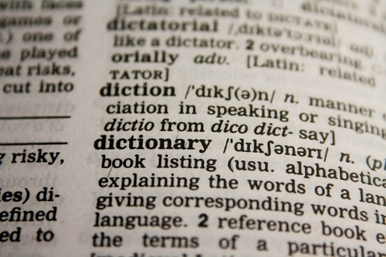
Data structures – collections - dictionaries
Pairs of keys and values
Order doesn’t matter
Items retrieved by key or value
Dictionary<string, string> codingLanguages = new Dictionary<string, string>();
codingLanguages.Add("C#", "The best programming language in the world");
codingLanguages.Add("Java", "Named after its inventor's favourite coffee");
codingLanguages.Add("Scratch", "Cool for kids");
C# | The best programming language in the world
Java | Named after its inventor’s favourite coffee
Scratch | Cool for kids

Slide 74
Data structures – collections - dictionaries
Dictionary function | Code
Declaration | Dictionary<string, string> languagesDictionary = new Dictionary <string, string>();
Adding a value | languagesDictionary.Add(“C#”,”The best programming language in the world.”);
Removing a value | languagesDictionary.Remove(“C++”);
Finding the number of items in the dictionary | dictionaryLength = languagesDictionary.Count;
Checking if something is in the dictionary | languagesDictionary.ContainsKey(“C#”); languagesDictionary.ContainsValue(“The best programming language in the world.”);
Using a key to look up a value | string result; bool found; found = languagesDictionary.TryGetValue(“C#”, out result);
out is a C# keyword

Slide 75
Data structures – dictionaries - exercise
Create a program that contains a dictionary of coding languages in which you can:
Check if a key is in the dictionary
Check if a value is in the dictionary
Use a key to look up a value
List all entries
Count the list
Exit
Extension: allow the user to add or remove dictionary entries
CodingLanguages, CodingLanguagesExtension

Slide 76
Error handling

Slide 77
Error handling
Handling errors prevents a program from crashing
Try … catch … finally used to handle errors
C# can throw exceptions, and you can write your own, using throw
Try
Put this around the code that might cause an exception
Catch
Put this around the code that will respond to the exception
Multiple catch blocks allowed
Finally
Code that will execute whether or not there has been an error

Slide 78
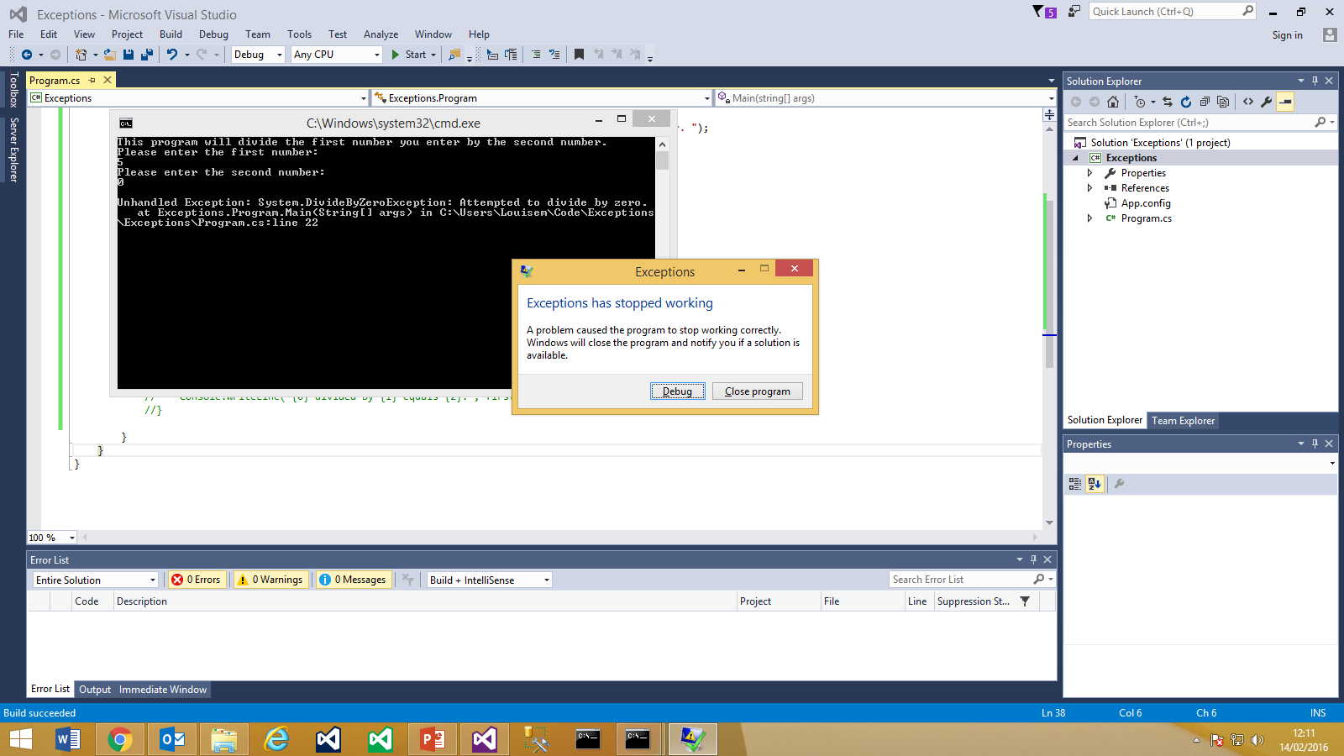
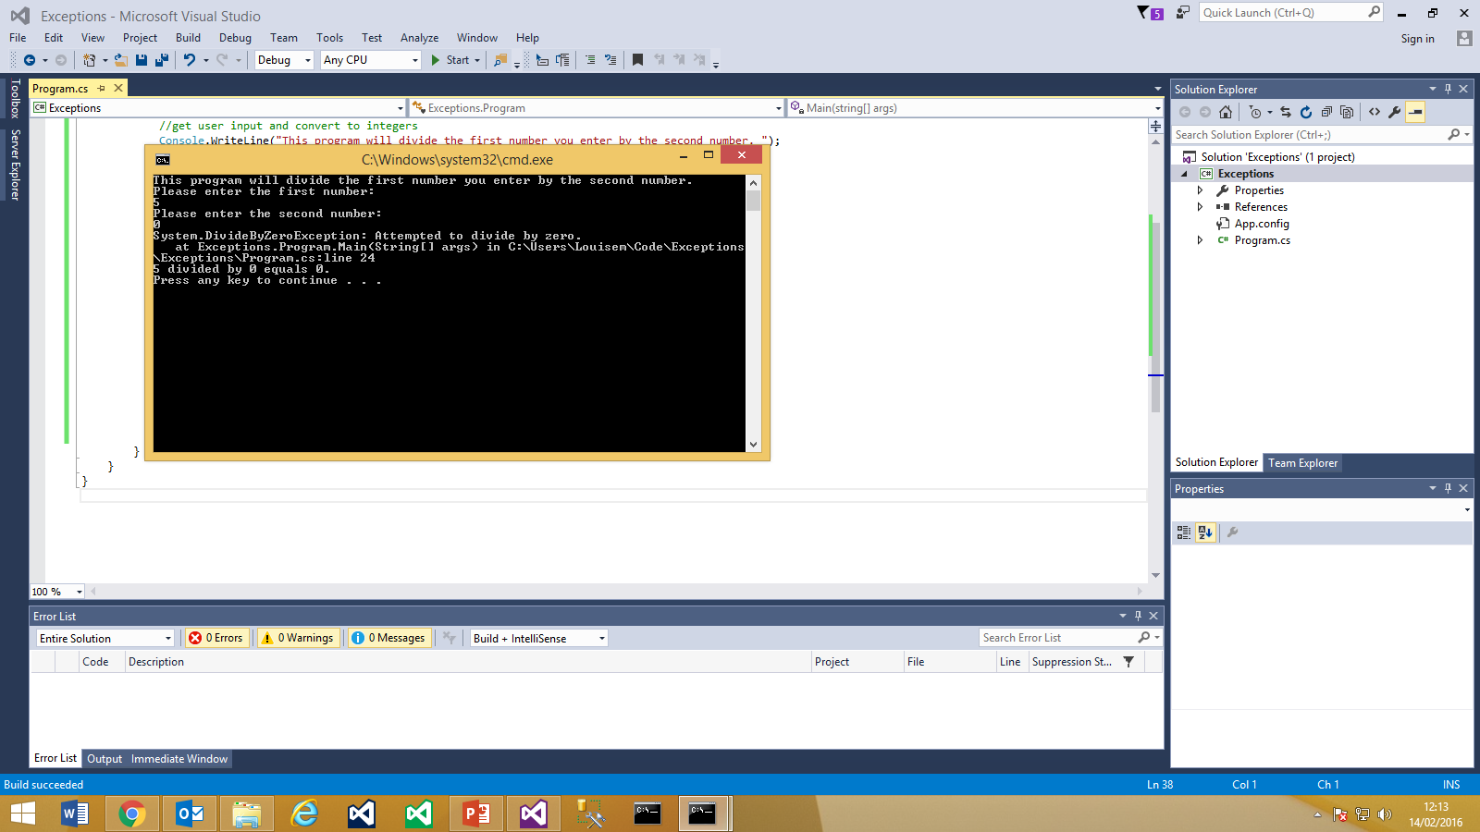
Unhandled exception
Handled exception

Slide 79
Error handling - exceptions
C# provides many exceptions, including:
FileNotFoundException
IndexOutOfRangeException
ArgumentException
DivideByZeroException
No definitive list, but the following links might be helpful for an overview:
https://mikevallotton.wordpress.com/2009/07/08/net-exceptions-all-of-them/
http://blogs.msdn.com/b/brada/archive/2005/03/27/402801.aspx

Slide 80
Error handling - example
try
{
result = firstNumber / secondNumber;
}
catch (DivideByZeroException e)
{
Console.WriteLine(e.ToString());
}
finally
{
Console.WriteLine("{0} divided by {1} equals {2}.", firstNumber, secondNumber, result);
}

Slide 81
Error handling – file example
try
{
sr = File.OpenText(@"c:\Users\myfile.txt");
Console.WriteLine(sr.ReadToEnd());
}
catch (FileNotFoundException fnfe)
{
Console.WriteLine(fnfe.Message);
}
catch (Exception ex)
{
Console.WriteLine(ex.Message);
}
Console.WriteLine(“and the program continues …”);
}//end main
}//end class
}//end namespace
using System;
using System.IO;
namespace FileExceptionExercise
{
class Program
{
static void Main(string[] args)
{
StreamReader sr = null;

Slide 82
Error handling - exercise
Write a program that pushes an array over its boundary and handle the resulting exception
Extension: identify at least one more common C# exception and write code that will generate and handle the exception
ArrayExceptionExercise

Slide 83
Algorithms

Slide 84
Algorithms
Algorithms
Flowcharts
Decision tables
Sorting algorithms

Slide 85
Algorithms
An algorithm is a set of ordered and finite steps to solve a given problem
e.g. recipes, instruction manuals
Every program has an algorithm
Some familiar problems have standard algorithms
e.g sorting, drawing graphs, language processing, computer chess
TutorRobotExercise (in class)

Slide 86
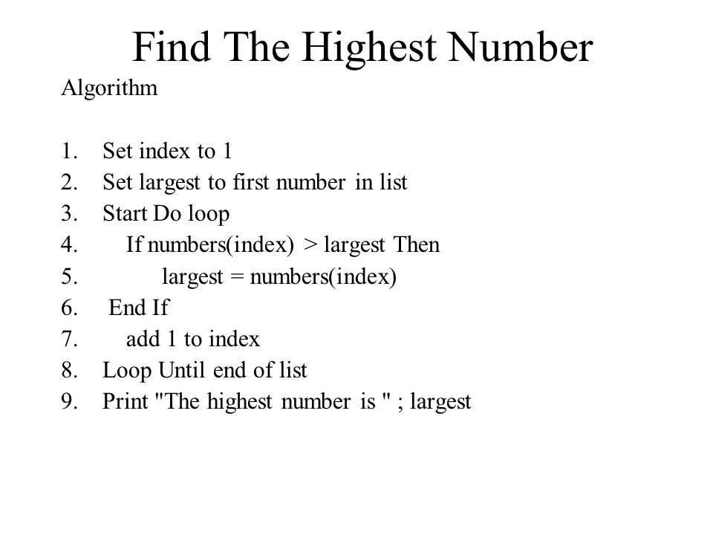

Slide 87
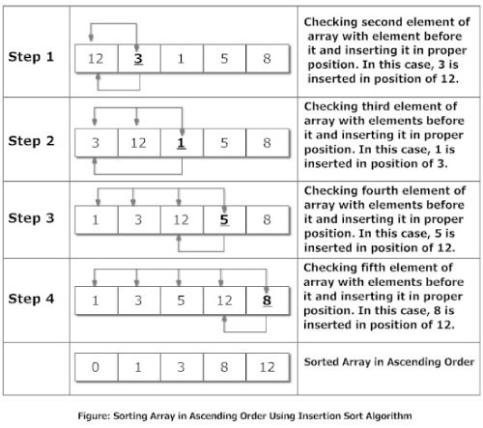
https://brilliant.org/wiki/sorting-algorithms/

Slide 88
Flowcharts
A flowchart is a graphical representation of an algorithm
Common Flowchart Symbols
 | Start or end of an algorithm
 | Process or computational operation
 | Input or output operation
 | Decision making operation
 | Direction of the flow of control

Slide 89
Flowcharts - example
A flowchart that compares two numbers
Start
Input x
Input y
x > y?
No
Output y
Yes
Output x
Stop

Slide 90
Decision tables
Can be useful for evaluating several conditions
Quantity < 10 | Y | N | N | N
Quantity < 50 | Y | Y | N | N
Quantity < 100 | Y | Y | Y | N
Discount | 5% | 10% | 15% | 20%

Slide 91
Sorting algorithms
Bubble sort
Compare 2 items in a list
If they are out of order, swap them
Continue along the list to the end, swapping any pairs that are out of order
Repeat from the start of the list until no more swaps needed
Example:
First pass: 3,4,1,2 3,1,4,2 3,1,2,4
Second pass: 3,1,2,4 1,3,2,4 1,2,3,4
Third pass: 1,2,3,4 1,2,3,4 1,2,3,4
Animation: http://www.cs.armstrong.edu/liang/animation/web/BubbleSort.html

Slide 92
Sorting algorithms
Quick sort
Probably the fastest sorting algorithm
Uses divide and conquer idea – list is subdivided into halves, quarters, etc., until sorts are easily done
Example
 |  | 5,1,3,2,4 |  |  | Choose a pivot element, e.g. 3, and divide the list into 3
 | 2,1 | 3 | 5,4 |  | Move everything less than 3 to the left list and everything greater than 3 to the right list
1 | 2 | 3 | 4 | 5 | Choose a pivot element in the left and right lists and move everything less than the pivot to the left and everything greater to the right. The lists now consist of single elements, which are sorted.
 |  | 1,2,3,4,5 |  |  | Put the lists back together to form a sorted list

Slide 93
Quicksort
Animation
https://commons.wikimedia.org/wiki/File:Quicksort-example.gif
Quicksort vs. bubblesort
https://www.youtube.com/watch?v=vxENKlcs2Tw

Slide 94
Summary

Slide 95
Summary
Study skills
Computer storage
Data types
Selection structures – if and case
Iteration structures – while, do, for, foreach and recursion
Data structures – arrays and collections, including lists and dictionaries
Error handling
Algorithms and sorting

Slide 96
Mini-projects
Calculator that accepts 2 numbers and a sign, then gives the result
List of books and authors that allows you to add, delete, sort, etc.
A “Guess the Word” game
A house price calculator, which accepts a city, valuation and date from the user and works out what their house is worth now. (Use a multidimensional array and a limited data set, e.g. 3 cities and 10 years’ worth of price changes. To get an idea of the functionality, look at http://www.hpc2.louisemcdonald.name/)
Sort an array of strings input by the user using bubble sort
Sort an array of randomly generated numbers using quicksort

Slide 97
Using the C# book
Chapter 2 is useful for using Visual Studio, but just look at console applications for now
Chapter 3 is useful for syntax, variables and expressions
Chapter 4 is useful for if, switch, loops and Boolean logic
Chapter 5 is useful for type conversions and arrays
Skip enums and structs and jagged arrays
Chapter 6 is useful for functions (methods) and scope
Skip command-line arguments and delegates and (for now) overloading
Chapter 7 is useful for error handling
Skip debugging for now

